Slide 1
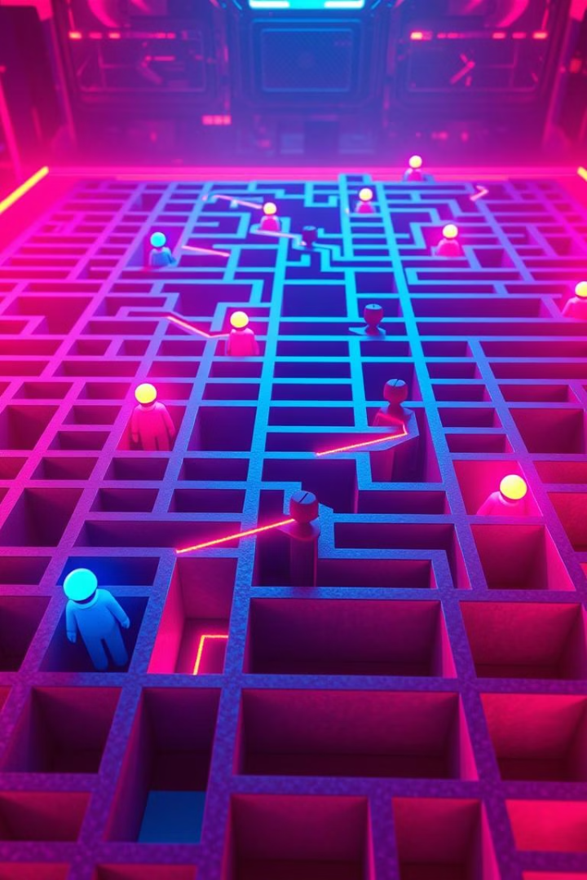
Multi-Agent Maze Solver
Adith Anish, Adithyan S Nair, Mohamed Hani, Sravan Chandrakanth
This presentation will introduce a multi-agent maze solver that utilizes the conflict based search using A\* search algorithm and to navigate a grid-based maze. The project involves the development of an interactive user interface for designing mazes and adding agents dynamically.

Slide 2
Project Objectives
1
Understanding Multi-Agent Maze Solvers
Implementing Conflict based Search Algorithm
2
Gain a comprehensive understanding of multi-agent maze solvers and their complexities.
Develop an agent that can navigate the maze using the Conflict based search algorithm.
3
Interactive User Interface
4
Dynamic Agent Addition
Create an interactive user interface for designing and manipulating mazes.
Enable dynamic addition of multiple agents to the maze with different starting points.

Slide 3
Agent Behavior
Independent Operation
Heuristic-Based Decision Making
Each agent operates independently, making its own decisions based on heuristics.
Agents use heuristics to determine the most optimal path, avoiding obstacles and other agents.

Slide 4





Project Significance
Path Planning Problems
Robotics and Autonomous Vehicles
Enhances solutions for path planning problems in complex environments with multiple agents.
Provides valuable insights for future developments in robotics and autonomous vehicles.
Transportation and Logistics
Decision-Making in Dynamic Environments
Applicable to real-world applications such as task scheduling and transportation of goods.
Offers guidance on decision-making in dynamic environments with multiple interacting agents.

Slide 5




Project Focus
Agent Interaction Enhancement
1
Improve the interactions of agents in various simulations and real-world situations.
Time-Effectiveness and Variability
2
Focus on developing solutions that are both time-effective and adaptable to changing conditions.
Flexible Integrated Systems
3
Design flexible integrated systems to solve progressively complex problems.
Future Developments
4
Lay the groundwork for future developments in areas like robotics and autonomous vehicles.

Slide 6
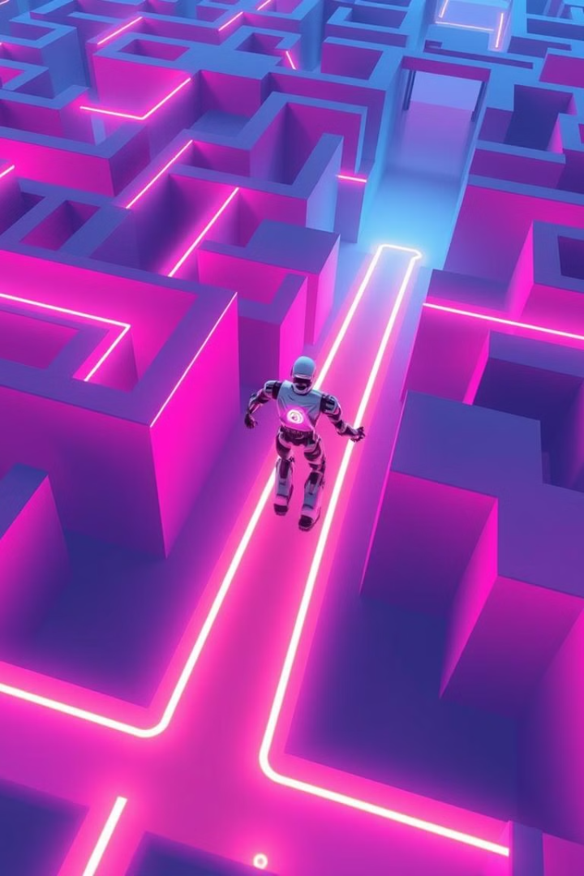
Benefits of Conflict-Based Search (CBS) Algorithm
Optimal Multi-Agent Pathfinding Ensures efficient and conflict-free paths for all agents in a shared environment.
Dynamic Conflict Resolution Dynamically detects and resolves conflicts between agents, ensuring smooth navigation.
Scalability Effectively handles environments with multiple agents, scaling well for larger systems.
Adaptability Adjusts to changes in the environment, such as new obstacles or modified agent priorities

Slide 7

Application Areas
1
2
Robotics
Autonomous Vehicles
Navigation and path planning for robots in complex environments.
Optimizing routes and avoiding obstacles in autonomous driving.
3
4
Game AI
Logistics and Supply Chain
Controlling non-player characters (NPCs) and simulating realistic behavior.
Optimizing delivery routes and managing resources in complex logistics networks.

Slide 8
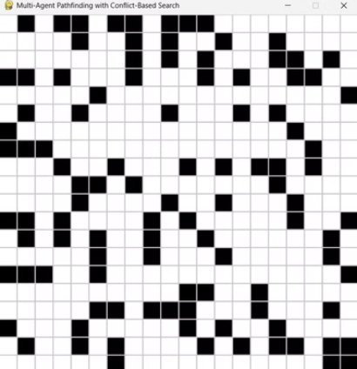
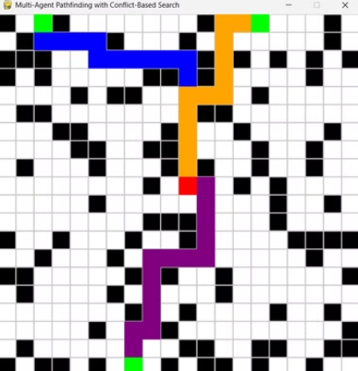
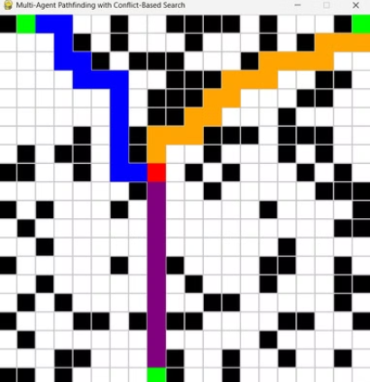
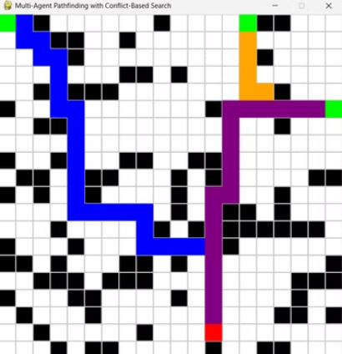
Different Outputs:

Slide 9
Conclusion
Multi-Agent Maze Solver
1
Provides a valuable framework for understanding and solving multi-agent pathfinding problems.
CBS Algorithm
2
Offers a powerful and efficient solution for finding optimal paths in complex environments.
Future Research
3
Further exploration of advanced AI techniques and the development of more sophisticated agents.
Notes:
The Multi-Agent Maze Solver provides a valuable framework for understanding and solving complex multi-agent pathfinding problems. The A* Search Algorithm offers a powerful and efficient solution for finding optimal paths in challenging environments. Future research should focus on exploring advanced AI techniques and developing more sophisticated agents to tackle increasingly complex scenarios. The presentation will conclude by providing the code for the program, which implements the key concepts discussed throughout the talk.

